Slide 1
BWRC
Test Plans and Test Boards for Chips
Motivation & overview
Info regarding vendors and assembly choices/considerations
Form to be filled out by lead student:
Die-attach and assembly requirements for test board to be fabricated
Test plan
Tests of die-attach after each subsequent fab/assembly house
Tests of functionality after assembly
Appendix A: Docs/materials to send to vendors
Appendix B: Considerations for before tape-out
Appendix C: Terms related to packages, footprints & die-on-board assembly
Do Not Distribute

Slide 2
Motivation
There is a new procedure at BWRC for how boards are designed, fabricated and tested because:
Many vendors are involved.
Extensive human communication is involved.
There have been many errors, misunderstandings and wastes of time/money in the past.
This new procedure is an attempt to think ahead, catch problems, and ensure students understand the time required to prepare for and shepherd a board design through the entire vendor fabrication process.
For a chip design, there is one vendor and one process. For the test board, there are many possible variations and every board requires design of the process. In addition to many vendors being involved, there are several different types of vendors. Each vendor requires different documentation, design files, requests for quotes, purchase requests, sign-offs and humans to talk to. Human communication has to be done clearly, in Precise English, and in writing/pictures.
Overview of the New BWRC Test Board Process
1) Each board run will have two students assigned to it:
a primary student (Chief Shepherd)
his/her second-in-command (First Mate).
2) If the Chief Shepherd desires to enlist the services of BWRC Staff, there will be a staff member:
(Supreme Guru) who works with the Chief Shepherd

Slide 3
Responsibilities
1) Chief Shepherd
Fills out the attached Test Plan form (preferably before the die design is sent out) and is the Supreme Guru’s point of contact
Holds a Test Plan Review with First Mate and at least 2 other students
Written Test Plan should include die-attach tests to be done between sending boards on to the subsequent vendors
Maintains a log of testing results and then saves Test Reports to the board repo … for institutional memory
Prepares the board schematic and chooses physical parts to use (i.e. supplies manufacturers’ part numbers)
Communicates with the chip design team to reach consensus on assembly choices, which vendors to use, how many boards to request quotes for, how many to get stuffed, what the order of vendors will be, etc.
Communicates with the Chief Shepherd of another board project if more than one board design is to be fabricated on a given panel
Communicates with all vendors:
Submits requests for quotes
Submits purchase requests
Orders parts
Delivers or mails parts/boards to fab/assembly houses
Responds to design team for all questions from design team regarding when boards will be back
Tests and debugs the board. Follows up with vendors on all issues including die attach, board fabrication mistakes, assembly mistakes, & stencil issues
Writes up the Test Report and pushes it the repo before requesting Supreme Guru to help with a re-spin
2) First Mate
Helps the Chief Shepherd with whatever the Chief Shepherd requests of him/her

Slide 4
Responsibilities
Supreme Guru
Communicates with the Chief Shepherd
Maintenance of Part Sync components database (BWRC.mdb) to ensure naming conventions and correctness
Maintenance of Altium schematic, footprint and pad/via libraries (BWRC.PcbLib, BWRC.SchLib, BWRC.PvLib) to ensure consistency
Guidance to the Chief Shepherd regarding stack layups, board materials/plating, and shepherding a board thru vendors
Designs the board stack layup (i.e. via communicating with the Board Fabrication House)
Creates the PCB layout in Altium
Creates Gerbers and package models for checking packages to footprints in BOM Builder
Creates Assembly BOM (BOM = Bill of Materials) for number of boards to be stuffed for use by assembly house
Create Purchasing BOM for components for number of boards to be stuffed, for Chief Shepherd’s purchasing task
Creates Smart PDF for use by assembly house
Checks ODB output files in Viewmate Deluxe and in EMS Magician
Creates ODB output design files and documentation files which Chief Shepherd sends to each vendor for requests for quotes
Board fabrication house files
Die attach house files
Pastemask stencil house files
Board assembly house files
Creates pptx documentation and instruction files in Precise English for Chief Shepherd to send to each fab/assembly vendor
Designs mechanical fixtures for test setups in Solidworks.
Orders materials, and interfaces with machinist (Ivan Hobson Machining, Rockridge)
Delivers stock material to machinist and picks up finished machined parts
Verifies that the Chief Shepherd has undertaken a Test Plan Review with First Mate and at least 2 student reviewers
Quality control on the entire process to catch design/assembly mistakes
Oversees Chief Shepherd’s communications with vendors and endeavors to catch mistakes in Human Communication

Slide 5
Test Plans and Test Boards for Chips
Motivation & overview
Info regarding vendors and assembly choices/considerations
Form to be filled out by lead student:
Die-attach and assembly requirements for test board to be fabricated
Test plan
Tests of die-attach after each subsequent fab/assembly house
Tests of functionality after assembly
Appendix A: Docs/materials to send to vendors
Appendix B: Considerations for before tape-out
Appendix C: Terms related to packages, footprints & die-on-board assembly

Slide 6
Board Fabrication Considerations
The Chief Shepherd and First Mate need to collect information to give to the Supreme Guru. Think through all these issues and choices:
Vendors for bare board fabrication used by BWRC in the past:
For fine-pitch, extremely complex boards
Sierra Proto Express (protoexpress.com, Sunnyvale)
Qualifies as a minority/woman-owned business, makes POs over $5K do not require 3 competing quotes
Streamline Circuits (streamlinecircuits.com, Santa Clara)
Cirexx (cirexx.com, Santa Clara)
For intermediate-complexity boards
Bay Area Circuits ( bacircuits.com, Fremont)
Information to gather:
To determine what board surface finish (i.e. plating type) is required, decide if chip will be:
Packaged into its own custom BGA package (i.e. vendors such as Keyocera, or foundries, etc.)
Composition (leaded or unleaded solder) of BGA balls? Nominal diameter and pitch of BGA balls?
Wirebonded directly onto the board
Are cavities for the die required for the die to sit down in on the board?
Flip-chip die assembled directly onto the board (i.e. die-on-board attachment)
Composition (leaded or unleaded solder) of die bumps? Nominal diameter and pitch of die bumps?

Slide 7
Board Fabrication Considerations (cont’d)
Board laminate choices:
Low-loss laminates used at BWRC in the past
Panasonic Electronic Materials Div., Megtron6 or Megtron7N
US distributor is Matrix Circuit Board Materials (matrixelectronics.com for datasheets, Santa Clara)
Isola iTera-MT40, Astra-MT77 or Tachyon 100G (michael.gay@Isola-group.com)
Lossy, less expensive laminates
Isola 370HR (isola-group.com, Arizona)
Not all board houses have all possible laminates in stock. Need to plan ahead to ensure the board house can get the material.
Laminate costs are not all that significant in the bigger scheme of things.
Board stiffener requirements:
Solder is very brittle. For die-on-board designs, dies are usually put on by the die-attach house with underfill. Even with underfill, for boards which need to be inserted into FMC connectors, some die-attach vendors (e.g. Jabil) have warned us about applied stresses during insertion, causing cracking of the die’s solder bumps. Jabil has recommended the board be at least 98 mils thick.
Problem! Mechanical drills can only drill 10:1 aspect ratios. If you need 6 mil drills (6 mil is the smallest mechanical drill), then the board can be no thicker than 60 mils. In this case, you may want to design a stiffener, such as Lexan (polycarbonate). For boards with die-attach done without underfill, be very careful with applied stress.
Controlled impedance traces:
The board house does not do a frequency-based impedance test … they do a TDR (time domain reflectometry) test
Controlled-impedance traces must be placed with a random 2-decimal width and that has to be communicated to the board house
The board house will then adjust those traces’ width based on laminate squish thickness (proprietary info of the board house)

Slide 8
Board Fabrication Considerations (cont’d)
Board cap-and-plate choices:
If a footprint requires a via-in-pad, the board will require a cap-and-plate process
Means the via will be filled with non-conductive epoxy, capped with a copper pad that is plated up and planarized
Cap-and-plate is always done on buried vias which are stacked underneath blind vias
Board blind via (i.e. “wrap-plating”) requirements:
If a footprint requires a circular pad of 4 mil diameter or less, the board will require a wrap-plating/etching process for the outer layers
Means that the inner layers are laminated together as one submodule, while the outer layers are aligned/laminated on separately
Outer layers that are wrap-plated can allow the board house to accurately etch the < 4 mil diameter pads w/o over-etching
If there are blind vias in such outer layers, those vias automatically get filled with copper and have flat tops
That is, such blind vias don’t have to be filled w/conductive epoxy, plated up, planarized and etched
Thus fine-pitch, controlled etching is achievable on the top layer such that 3 mil diameter pads for die-on-board are viable
Drilled hole density requirements:
For plated-through holes, inner plane layers which are un-connected must have anti-pad clearances
Tight density of neighboring holes means the anti-pad clearances can eat up the GND plane
A GND plane that looks like swiss cheese might force GND currents to take circuitous routes
Plane layers require 8 mils (!) of clearance from the outer edge of a plated via barrel to the next bit of different-net copper on a plane layer
Carefully consider die bump density design for this board house constraint
Less than 8 mil “hole-to-copper” clearance increases board cost dramatically
Mechanical drills: 6 mil diameter is minimum and 10:1 aspect ratio
Laser drills: vias on outer wrap-plated layers can only go from one layer to the next and 4 mil diameter is minimum, and 0.7:1 aspect ratio

Slide 9
Board Fabrication Considerations (cont’d)
Component distance from edge of board:
Assembly house typically wants no components closer than 30 mils from an edge
Metal distance to the edge of the board:
Varies by board house, but Sierra will move your metal fill back 10 mils from the edge if you draw it all the way to the edge of your board
Fiducials:
Assembly house wants fiducials so they can optically align their robot
Fiducials should be close to opposite corners, and on both sides of the board
Fiducials should be round pads, or crosses, but no holes
Preferably 1 to 1.5 mm in diameter
Soldermask opening a few mils beyond the outer edge of the fiducial
No pastemask opening in the fiducial’s footprint
Die-attach house also wants fiducials
Fiducials should be close to the die, preferably two … near diagonal corners of the die

Slide 10
Die Attach Considerations
Talk to the die-attach house to understand their requirements and/or interactions with designer’s constraints:
Quik-Pak (icproto.com), Jabil Blue Sky (jabil.com/contact/locations/blue-sky-center.html), Nexlogic (www.nexlogic.com), Advotech (www.advotech.com).
Flip-chip die-on-board:
Thickness of gold on board surface finish?
Soldermask or not under the die? (Fader2 and Eagle1_revX2 had (sort of) successful die attach with soldermask under the die, via Quik-Pak)
Solderpaste or flux dip? (determines if you need to create a pastemask opening layer for your die’s footprint).
For Fader2 and Eagle1_revX2, no solderpaste was used by Quik-Pak, just a flux-dip onto a board with ENIG finish
Underfill or not?
Wire bonding
Wedge bonding or ball bonding?
Ribbon bonds or circular cross-section bond wires?
Type of metal for bond wires?
Requirements for RF capacitors (that are wire-bonded to)?
Sizes of board footprints to accept wire bonds?
Interactions with assembly of SMT/thru-hole parts
Does the die-attach house want to go first or second?
Backside components pre-assembled means the die-attach house will need to machine a fixture to hold the board flat
Backside components assembled after die-attach means the die will not only go through reflow ovens, but also washing machines
Dies need to be protected from moisture
Dies need to be protected from random bits of metal during any soldering of hand-assembled frontside components
Ask assembly house if they can protect the die

Slide 11
Assembly (SMT and Thru-hole) Considerations
Digicom (digicom.org), Nexlogic (nexlogic.com), Jeditron (jeditron.com)
Having the assembly house buy your parts:
Most assembly houses will do this for a mark-up fee
Typically, we buy the parts at BWRC and deliver/mail the parts/boards to Digicom
Buying parts and having them in hand during the design phase can prevent footprint errors
Always print out a pdf of a footprint at 1:1 and physically place the part down on the printout to check footprint correctness
SMA connectors:
The assembly house always must do these by hand
SMA (or any RF connectors with plastic dielectric) will likely go out-of-spec during soldering
BWRC has an SMA gage-kit in the (large) SMA tupperware box above the soldering bench
Use the gage kit to ensure that newly-bought SMA connectors are in-spec before delivering them to the assembly house
SMA heat sinks and an SMA torque wrench are in the same tupperware box
Send these along with your parts/boards to Digicom and Digicom will use these when they solder on SMA connectors
Re-gage the SMA connectors when you receive your boards back to ensure the SMA are still in spec
Spare Boards/Parts:
If your board has an FMC connector, the board house will want to run a reflow test of the FMC on a spare blank board
Always give the board house a few spare boards and spares of each component
Documentation to give to the assembly house:
Assembly BOM report from BOM Builder for desired number of boards to be stuffed
Smart pdf of board
Precise English instructions

Slide 12
Pastemask Stencil Considerations
Beam On (www.beamon.com)
BWRC has its own pastemask stencil frame, bought from Beam On. It lives on top of the reflow oven under the soldering bench
For a given board design, you can order frontside and backside pastemask stencils from Beam On
Beam On will also machine a fixture to hold your board into the frame
You can use this to apply solderpaste for boards you want to stuff yourself
Or you can take the set to Digicom and have Digicom use this pastsemask stencil set when they assemble your boards
From Beam On, it’s possible to order “partial, folded-up” stencils, if your board will already have a die on it from a die-attach house
Alternatively, you can always have your assembly house order their own pastemask screen, but the assembly house will keep it
Note that not all of the footprints on your board will require solderpaste. Footprints that do not need solderpaste include:
Die to be attached with a flux dip
Fiducials
Mounting holes
Thru-hole components
Some components require pastemask openings to have a different shape than the footprint pad:
FMC connectors typically require square-rounded-corner patterns for pastemask openings, as FMC connectors need a bit extra solderpaste

Slide 13
Test Plans and Test Boards for Chips
Motivation & overview
Info regarding vendors and assembly choices/considerations
Form to be filled out by lead student:
Die-attach and assembly requirements for test board to be fabricated
Test plan
Tests of die-attach after each subsequent fab/assembly house
Tests of functionality after assembly
Appendix A: Docs/materials to send to vendors
Appendix B: Considerations for before tape-out
Appendix C: Terms related to packages, footprints & die-on-board assembly

Slide 14
Dicing, Die-attach and Assembly Requirements for Test Board to be Fabricated
Chief Shepherd name/email/cell: Marko Kosunen/marko.Kosunen@aalto.fi/+358 40 566 4963
First Mate name/email/cell: Gregory Wright/Gregory.Wright@Nokia-bell-labs.com/732 977-2844
Supreme Guru name/email/cell: Anita Flynn/aflynn@eecs.berkeley.edu/510-681-3931
Die and board names: Fader2.1 Fader25
Will there be more than one board design per panel (w/same layer stack-up, obviously)? No
Will a board be needed to test microstrip/stripline performance? No
Will die be wirebonded, in a custom BGA package or flip-chipped (die-on-board)? If yes, list which: Yes. Flip-chip die-on-board
How many copies of this die are to be attached to the board? 1
Do any mechanical fixtures for a test setup need to be designed/fabricated? If so, describe: No
Preferred board fabrication house? TBD
Preferred wirebonding house? N/A
Preferred die attach house? TBD
Preferred assembly house? TBD
Do you want the assembly house to order components? Yes
Preferred pastemask stencil house? TBD
Total number of (bare) circuit boards to be fabricated: 16
All boards to which the FADER die is attached should have the rest of the SMT components attached.
Other requirements (e.g. tented vias, vias-in-pads, vias-between-pads, ~3 mil circular pads, etc.)? Check Fader2.0 Board. Impedance matched transmission lines for LO feed and Antenna routing.
Tasks requested of the First Mate by the Chief Shepherd? If yes, please list: TBD
Please write up a Test Plan on the following slides (insert new slides as needed) and do a Test Plan Review with First Mate and at least 2 other students. Then have your advisor review it for last-minute changes.
After Test Plan Review, list names of reviewers: TBD
Name of advisor(s) and date they reviewed it:

Slide 15
Dicing, Die-attach and Assembly Requirements for Test Board to be Fabricated (cont’d)
How many boards do you want stuffed? (For flip-chip die-on-board, explain the desired order of assembly and if underfill is desired or not):
We want 35: our die has 6 different ADC designs on it. We want 5 separate boards to test for each ADC design, so we want 30 boards stuffed where the die on each of the 30 boards gets underfill. Then we want an extra 5 boards where the die is attached without underfill. Each of these 35 boards should go through backside assembly of components at Digicom first (i.e. sent through Digicom’s solder-reflow oven). These 35 boards will then go to Advotech for die attach. (Advotech will need to singulate the superdie into the 6 individual designs and also fabricate a fixture to hold the board since it will not lie flat, due to backside components (the largest backside component is a big 400-pin FMC connector). Advotech will do resistance measurements from testpoints to GND to ascertain if die-attach is successful. When these 35 boards return from Advotech, we will repeat these measurements to verify.
Do you want the board to have soldermask under the die? Yes
Do you want the die attached at Advotech with solderpaste? No, Advotech will buy 75um solder spheres and hand assemble them onto pads and then reflow them. This will replace any solderpaste step.
Do you want underfill under the die? Yes, on 30 boards and no underfill on 5 boards
How many boards do you want the board house to fabricate? 40, so that we have a few spares for assembly/die-attach houses to do tests
Do you want Digicom to buy parts for you? Yes
Do you want Digicom to buy pastemask stencils for you? Yes
Do you have a parts list with manufacturer’s part numbers? Yes
If you have SMA connectors, do you want Digicom to do assembly using heat sinks screwed into the SMAs during the soldering step? No
For footprint design in Altium, the Supreme Guru needs to understand your die’s bumps. What is the bump pitch on your die? 170um
What is the metallurgy of the bumps? Copper
What is the nominal diameter of each bump? 98um (18.5um thick copper pad)
For die-on-board design, add details of die dimensions on next slide(s).

Slide 16
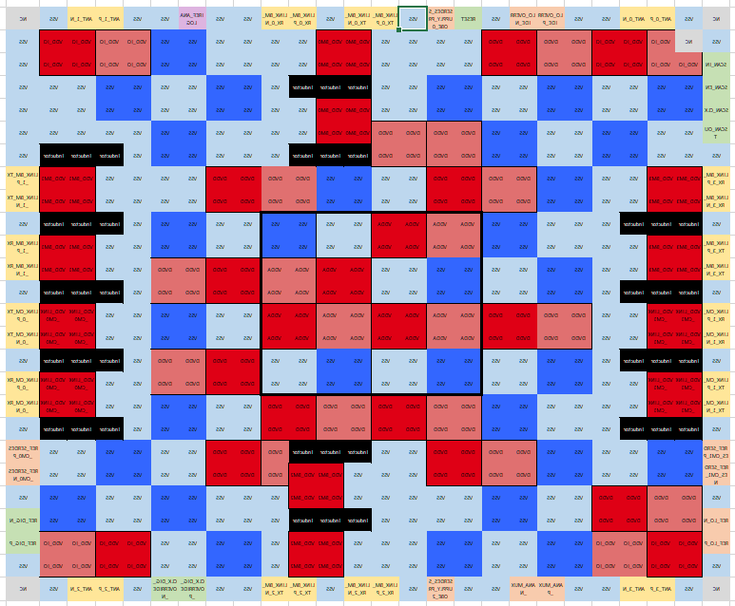
Dicing, Die-attach and Assembly Requirements for Test Board to be Fabricated (cont’d)
Please paste a screenshot of your Excel “bumps down” picture here:
What surface plating do you want on your board? TBD
Did you put a corner mark or other orientation mark on your die? Yes, a missing bump indicacted NC on the top right corner of the bump layout.
Did you show the location of this mark on your Excel spreadsheet drawing? Yes
What dielectric laminate material do you want for the board’s layer stackup? TBD
Do you have a higher resolution pic? I can read this even if I expand it.
Greys and blacks have no bumps.

Slide 17
Dicing, Die-attach and Assembly Requirements for Test Board to be Fabricated (cont’d)
Please paste a screenshot of your Altium schematic symbol here:

Slide 18
Test Plan: Tests of Die Attach after each Subsequent Fab/Assembly House
TO BE DEFINED FOR FADER2.1
First: after receiving the 40 bare boards back from the board house they need to be given serial numbers:
Mark 30 boards with “5”, “4”, “3”, “2”, “1” or “0” with suffix “a” through “e” for each letter (6 different designs, 5 of each)
These die will all get underfill and glop-top
Use magic marker (also a diamond scribe, just in case Digicom’s washing machine erases the marker)
Mark 5 boards with one of “5”, “4”, “3”, “2”, “1” or “0” with suffix “f” through “j” for each letter (1 of the 6 designs, 5 of them)
These die will all get glop-top, but no underfill
Use magic marker (also a diamond scribe, just in case Digicom’s washing machine erases the marker)
Leave 5 boards unmarked, to be spare bare boards
Ohm out all 40 bare boards and verify no power domains are connected together, and none are shorted to GND
Create an Excel Test Report file and note serial number for each of the 40 boards. List any shorts
Push Excel Test Report file with these test results to board repo’s Testing directory
Second:
Send 35 (bare) boards to Digicom for SMT backside assembly (send along 2 of the spare bare boards)
When the 35 stuffed boards come back, ohm out all 35 boards’ pwr to gnd, just to make sure nothing got shorted by a bad component, bad footprint, bad solder joint, etc.
Update Excel Test Report file and push to the board repo’s Testing directory

Slide 19
Test Plan: Tests of Die Attach after each Subsequent Fab/Assembly House (cont’d)
TO BE DEFINED FOR FADER2.1
Third
Send all 35 backside-stuffed boards to Advotech for die attach (30 to be attached with underfill, 5 w/o underfill). Send along 3 spare bare boards for Advotech to practice on. Send along ~20 superdies plus some spares. Also send Advotech instructions on how to ohm-out certain testpoints, so that Advotech can tell if their die-attach process worked.
Ohm out all 35 die-attached boards from pwr to gnd, to make sure the die attach did not short them
Repeat the same resistance measurements on xxx_chip signals which Advotech measured to ensure die-attach worked
Update Excel Test Report file and push to the board repo’s Testing directory
Fourth
Send all 35 backside-stuffed and die-attached boards to Digicom for frontside (hand) assembly.
Make sure to tell Digicom that these die-attached board should not go through a reflow oven.
When boards return to BWRC, ohm out all 35 fully-stuffed boards from pwr to gnd, to make sure frontside assembly did add shorts
Update Excel Test Report file and push to the board repo’s Testing directory

Slide 20
Test Plan: Tests of Die Attach after each Subsequent Fab/Assembly House (cont’d)
TO BE DEFINED FOR FADER2.1
Finally:
Write FPGA test software.
Assemble the stiffener onto a newly-stuffed daughterboard
Assemble FPGA development board and motherboard onto the test-fixture plate’s standoffs
Plug the stiffener-attached daughterboard carefully into the motherboard’s FPGA socket
Screw in 2 socket-head cap screws to attach the daughterboard-with-stiffener to the test plate’s standoffs
Remove the 4 screws holding the stiffener onto the board
Lift off the stiffener (from this point, no forces or torques will be applied to the daughterboard)
Connect scan interface
Check the scan chain read/write
Read the on-chip memory
Connect input signal/clock to the test equipment
Check if the power consumption of the analog supply matches with the simulation
Analyze the ADC output

Slide 21
Test Plans and Test Boards for Chips
Motivation & overview
Info regarding vendors and assembly choices/considerations
Form to be filled out by lead student:
Die-attach and assembly requirements for test board to be fabricated
Test plan
Tests of die-attach after each subsequent fab/assembly house
Tests of functionality after assembly
Appendix A: Docs/materials to send to vendors
Appendix B: Considerations for before tape-out
Appendix C: Terms related to packages, footprints & die-on-board assembly

Slide 22
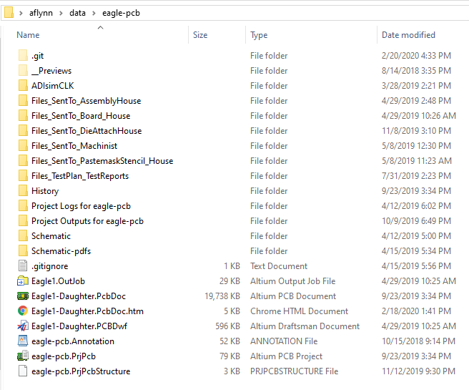
Appendix A: Files Required by Each Vendor
Here is an example cloned repo for an Altium board:
Eagle1 die’s boards: revX1 and revX2
The directories named Files_SentTo_xxx contain output files and pptx instruction files that we have sent to each vendor.
This is a good way to provide “institutional memory” to BWRC. We also keep quotes and final layer stackups sent back from the Board Fabrication House in these directories.
The .OutJob is the GUI where one directs Altium to create the output files (e.g. ODB++ zip file, pick-n-place file, testpoints file, pdfs, etc.) Altium stores the generated output files in the Project Outputs directory (which gets overwritten each time). Hence, we have a convention of copying the requisite output file (and giving it a name beginning with the date in YYMMDD format), to the appropriate Files_SentTo_xxx directory.
An Altium Draftsman file is used to create a Fab Drawing. This must be given to the Board Fabrication House. It is the document that will travel with the board through every step in the factory. The pastemask stencil house will also ask for it.

Slide 23
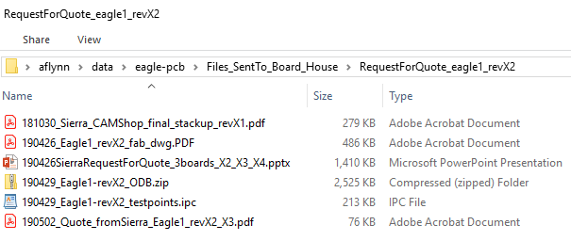
Files Required by Board Fabrication House
The board house requires:
Altium-generated output files
ODB++ zip file (newer format replacing gerbers)
Fab drawing
IPC-365A-D standard testpoints file (.ipc file)
Layer stackup
Typically requires extensive back-and-forth communications
Specifies laminates, thicknesses and controlled impedance traces
The CAM Shop at the board house will tweak it and send a final final version that they will use. That final version must be saved in this repo (for institutional memory about what was built)
Here, Sierra used the exact same stackup as revX1 from Oct ‘18
A .pptx file of detailed instructions for precisely communicating with the sales rep, what your intentions are, so that he/she can understand exactly what you want quoted. We typically send this as a pdf (in case someone at the factory doesn’t have Powerpoint), but we save the .pptx version to this repo.
Quote returned from board house
After the Quote Comes Back from the Board Fabrication House
If the quote is over $5K, UCB Purchasing will require quotes from 3 different companies, unless it’s a minority/woman-owned business (Sierra is)
Once you submit a purchase request, a request over $5K requires extra approvals (i.e. the ERSO admin for the professor’s account)
Once the final purchase order arrives at the board fabrication house, then it goes to the CAM Shop at the board house
The CAM shop will tweak the stack layup based on your ODB files’ metal density per layer … and send you back a final layup
Only after your final approval, will the CAM shop send your job into the factory (the quoted lead times starts after the CAM Shop)

Slide 24
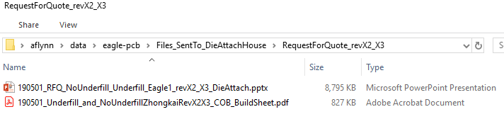
Files Required by Die-Attach House
The die-attach house requires:
Altium-generated output files
ODB++ zip file (newer format replacing gerbers)
Not explicitly copied to this directory since it’s stored up in the directory for files sent to the board house
A Quik-Pak build sheet
Quik-Pak gave us a pdf form to fill out
A .pptx file of detailed instructions for precisely communicating with both the sales rep and the packaging engineer.
Note: Quote had not been received back from Quik-Pak as of the time of this writing, but the quote will be stored in this repo.
After the Quote Comes Back from the Die Attach House
Submit a purchase request to Purchasing.
When the bare boards arrive from the board fabrication house, ohm them out as per your test plan
After the die-attach house has the purchase order, send the boards and dies to the die-attach house
This is assuming that the die-attach house goes first (i.e. before the assembly house) in your sequence
Print out your pptx instructions file and stick that in the box you send to the die attach house (even though you had emailed it to them w/your RFQ)
It’s best to write things down and be redundant. Most problems arise from human mis-communication.

Slide 25
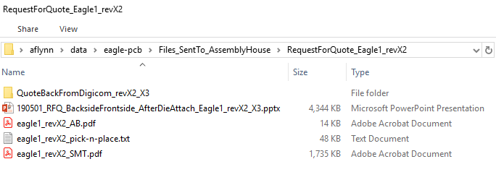
Files Required by Assembly House
The assembly house requires:
Altium-generated output files
ODB++ zip file (stored in dir for board house)
Pick-and-place file
BOM Builder-generated output file
Assembly BOM (AB) for number of boards to be stuffed
Smart PDF (SMT)
A .pptx file giving detailed instructions, quantities, contact person, etc.
After the Quote Comes Back from the Assembly House
Submit a purchase request to Purchasing.
When the boards with dies attached arrive back from the die-attach house, ohm them out as per your test plan
After the assembly house has the purchase order, send/deliver to the assembly house a box full of:
Printout of pptx instructions (even though you had emailed it to them w/your RFQ)
Also print out copies of the Assembly BOM and the Smart PDF of the board, and stick them in the box
If the assembly house will be using your pastemask stencils, include the pastemask stencil frame along with the stencils/jig from Beam On
If the assembly house will be attaching your SMA with heat sinking, include heat sinks and SMA torque wrench
Keeps the SMAs in spec for high-freq performance, by preventing the white dielectric from melting/moving during soldering
Once the assembly house receives all of this they will do a count of components to make sure all are there (including spares)
The quoted lead time starts once they have verified all parts are there

Slide 26
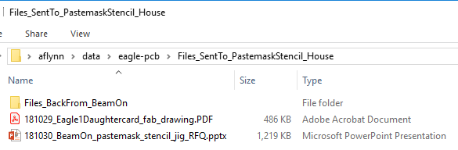
Files Required by Pastemask Stencil House
The pastemask stencil house requires:
Altium-generated output files
ODB++ zip file (stored in dir for board house)
Fab drawing
A .pptx file giving detailed instructions, quantities, contact person, etc.
Note: For Eagle1_revX2, we used the same frontside “partial, folded-up” pastemask stencils as was created for Eagle1_revX1. Separately, for revX2’s backside, we had Digicom order a pastemask screen that contained patterns for backsides of both eagle1_revX2 and eagle1_serdes_revX3.
After the Quote Comes Back from the Pastemask Stencil House
Submit a purchase request to Purchasing.
After the pastemask stencil house has the purchase order, their machine shop will send you a drawing of the jig for your approval
They work 24/7, so pastemask stencils/jigs are typically made overnight and shipped out the next day

Slide 27
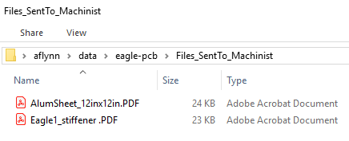
Files Required by Machinist
The machinist requires blueprints
Output from Solidworks model
Quote hadn’t been received as of this writing, but would be stored in this repo.
The Supreme Guru will Interface with the machinist for mechanical fixturing for test setups:
Usually we use Ivan Hobson Machining in Rockridge
Supreme Guru will order materials (usually from McMaster-Carr) and take them to the machinist, along with drawings

Slide 28
Test Plans and Test Boards for Chips
Motivation & overview
Info regarding vendors and assembly choices/considerations
Form to be filled out by lead student:
Die-attach and assembly requirements for test board to be fabricated
Test plan
Tests of die-attach after each subsequent fab/assembly house
Tests of functionality after assembly
Appendix A: Docs/materials to send to vendors
Appendix B: Considerations for before tape-out
Appendix C: Terms related to packages, footprints & die-on-board assembly

Slide 29
Appendix B: Things to Consider Before Tape-out of the Die
Think through how you will test your die
What’s the research goal?
Formulate, in Precise English, what the contribution to knowledge is that you’re hoping to achieve
Think about the graphs/tables that will go in a paper:
Sketch out graphs you plan to make, with titles, legends & labeled axes … but devoid of the data you plan to measure on your die
Write out tables comparing specs of competing chips ... albeit devoid of the data you plan to measure on your die
Design the die for testability
How many power domains?
Too many, and vias through your board might clear out GND planes
Too many, and you won’t be able to get decoupling caps close to the requisite vias
Lots of power domains require lots of layers in the board stackup (need GND planes between each for decoupling)
What bump-out pattern?
Full grid array of bumps, leaving no empty rows nor columns, might prevent accessing interior signals
Leaving empty rows/columns might allow getting decoupling caps on the board backside closer to the requisite vias
Can you gang same-net power bumps together in 2x2 arrays?
Might allow for “vias-between-2x2-quartets of pads”
Can you put all signals on the periphery only?
Allows for easier fanout and top-side microstrip access
Check with the die foundry on constraints for bumps (e.g. composition of bump material, pitch, diameter, empty positions, etc.)
Do you plan to have your die packaged?
Will you need to wirebond and/or probe your die on the Cascade Microtech probe station in the lab?

Slide 30
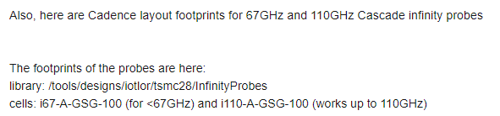
Things to Consider Before Tape-out of the Die (cont’d)
If you plan on probing your die with BWRC’s probe station:
Check which probes are available (most are either 100 μm or 150 m pitch)
If you need to order a probe, order early (they can have extended lead times)
Read this app note on pads for probing (from Cascade Microtech, recently bought by Form Factor)
Note that the probe end itself is wider than the pads on your die which you will be probing
Design your die to leave enough space from nearby bond pads, such that your probe can touch down and fit
Typically, dies to be probed will also have pads which need to be wirebonded (to bring in power, etc.)
Wirebond pads on the die and wirebond pads on the board need to be large enough to accept the wirebond
Contact your wirebond house (e.g. Quik-Pak, Nexlogic, etc.) about required board surface finish
A board house can put soft-bondable gold on your board’s pads which require wirebonding
… and cheaper (thinner) gold on the rest of your board
https://www.formfactor.com/download/infinity-probe-mechanical-layout-rules/?wpdmdl=1850&refresh=5cd3297fd6bd71557342591
Lorenzo Iotti has created some footprints for pad probing:

Slide 31
Test Plans and Test Boards for Chips
Motivation & overview
Info regarding vendors and assembly choices/considerations
Form to be filled out by lead student:
Die-attach and assembly requirements for test board to be fabricated
Test plan
Tests of die-attach after each subsequent fab/assembly house
Tests of functionality after assembly
Appendix A: Docs/materials to send to vendors
Appendix B: Considerations for before tape-out
Appendix C: Terms related to packages, footprints & die-on-board assembly

Slide 32
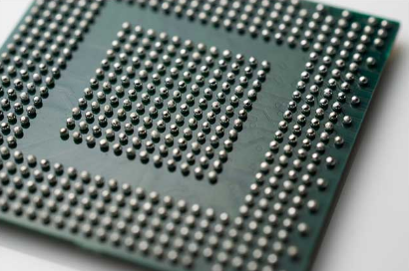
Appendix C: Packages and Die-on-Board Explained
There is a lot of lingo involved when a chip designer needs to communicate to a board designer. This appendix defines the terms used in this Test Plan Form.
What do we mean by package? interposer? flip-chip? die-on-board? chip-on-board? bump? ball? pad? footprint?
I use the word "ball" to refer to big solder balls that are put onto BGA packages, while I use the word "bump" to refer to the tiny solder bumps on your die when you receive your die from the foundry. A BGA package (ball grid array package) looks like this:

Slide 33
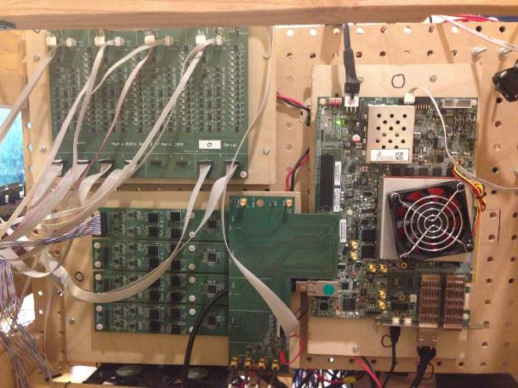
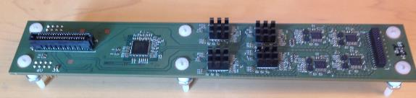
Of course, BGAs are just one type of package. In this document, when I use the word “package” I’m thinking of all the different types of packages of commercially available chips. For example, there are a number of different packages shown in this photo of one slice of the Discrete Hydra 1.0 basestation:
Discrete Hydra’s ADC board

Slide 34
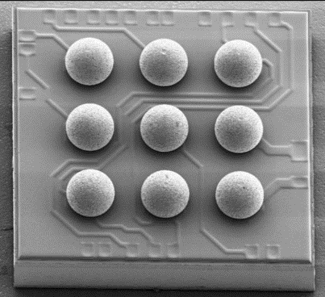
Less commonly, you can buy a “wafer-level-packaged chip” such as this part. For instance TI and Maxim have a number of chips which they sell in this sort of “package” (which is really un-packaged … i.e. no package at all). TI has a line of “tiny logic” in this form factor, and both companies sell small LDOs and switching regulators like this. This is just a silicon die with solder balls attached directly to a redistribution layer. Parts such as these typically come with a ball pitch of 0.4mm or 0.5mm … but never smaller than 0.4mm. Usually, these types of parts have only a few balls. The advantage of such an unpackaged chip is that it’s cheap and it saves space.
At BWRC, we wish to do something similar for the purpose of testing our custom dies. Mainly, it would be nice to not have to go through the expense and delay of getting a chip packaged by a packaging house such as Kyocera, etc. But before we get into some of the “die-on-board” attempts we’ve been doing at BWRC recently, let’s go back to wirebonding and BGAs.

Slide 35
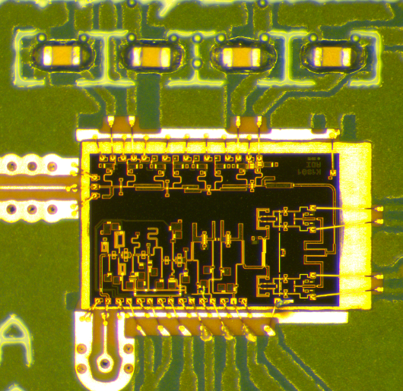
A number of BWRC projects have used wirebonded die. For instance, on this frontend receiver board for Discrete Hydra 1.0, there are 4 GaAs chips (LNA/downconverters) which are wirebonded directly to a printed circuit board (this could be called chip-on-board).
The board’s top side has laser-etch cavities that these die get glued into (which makes the wirebonds as flat and short as possible for least inductance):
Discrete Hydra 1.0 receiver board back side with packaged parts:

Slide 36
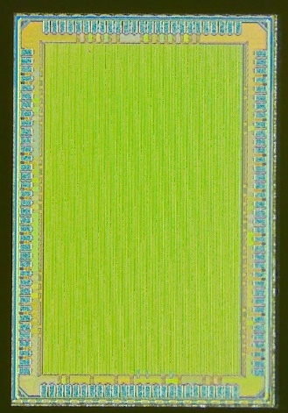
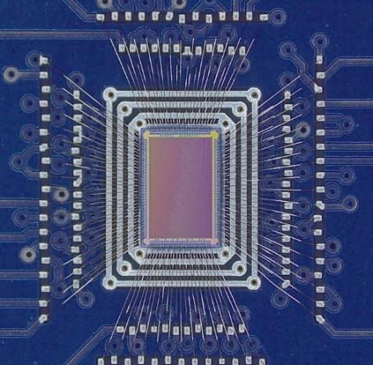
Another example is this BROOM (Berkeley Resilient Out of Order Machine) die, also wirebonded directly to a printed circuit board:
Glop-top (a type of epoxy) was poured over these wires after this wirebonding step to protect the fragile wirebonds from damage.
Die photo

Slide 37
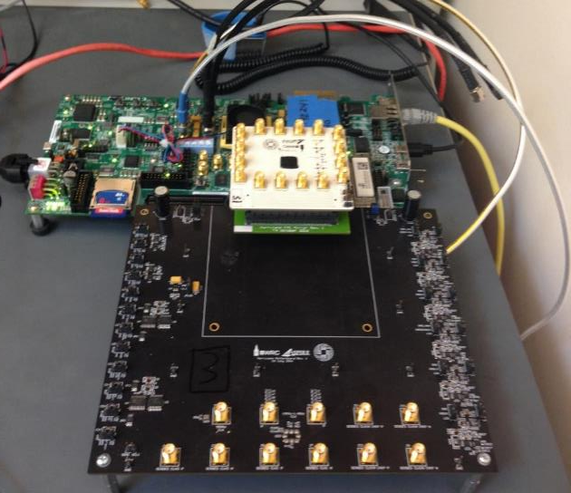
This white printed circuit board holds a glop-top die (Hurricane1) which was wirebonded similarly to the BROOM chip:

Slide 38
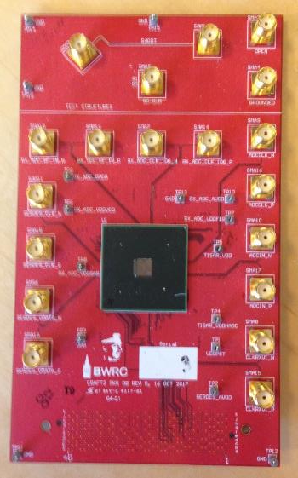
Other BWRC chips were packaged by a packaging house after the foundry run. For instance, this CRAFT2 chip was put in this BGA package after a foundry run. The test board was designed at BWRC and the package was assembled onto the test board by our local assembly house, Digicom:

Slide 39
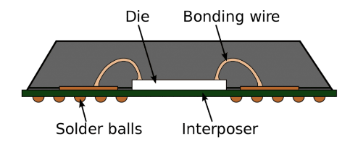
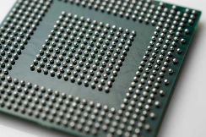
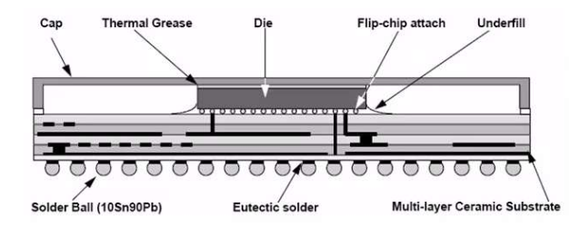
What does it mean to have a die “put into a BGA package”? It can mean a number of different things. Internal to the package, the die could have been wirebonded or it could have been “flip-chipped”. Flip-chipped means that the die came out of the foundry with tiny bumps on a very tight pitch … and then an interposer (fine-pitch) board was fabricated and the die was flipped over and solder-attached to the interposer board. Then underfill (a type of epoxy) was injected under the die. And then a cap (or some molded glop-top, another type of epoxy) was used to cover the die. And then big bumps on a large pitch (> 0.4mm) were attached to the bottom side of the interposer board. This BGA packaging is typically done overseas by specialty packaging houses (Keyocera, Amkor, ASE, etc.). It can be fairly expensive and those packaging houses primarily do large volumes. Other foundries/companies also might have in-house BGA packaging.

Slide 40
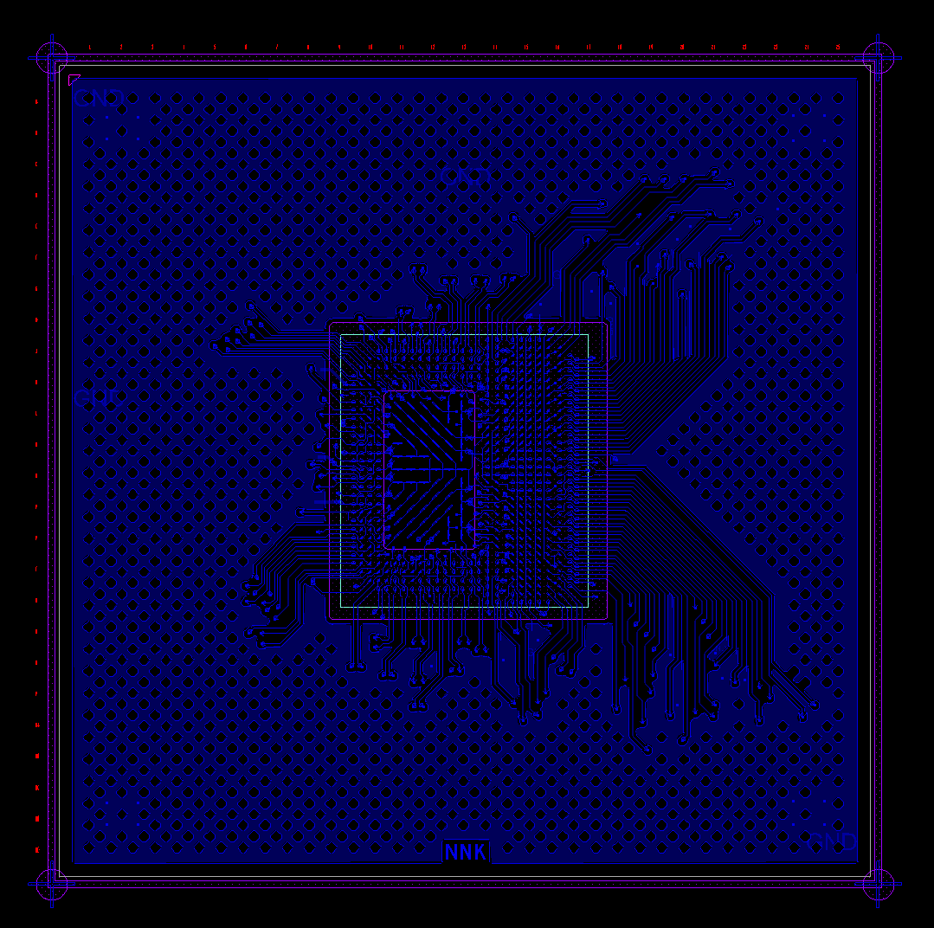
This slide and the next 3 slides show screenshots of layout for 4 layers of a 4-layer interposer board (created for the Hurricane2 die). The layout tool is similar to a printed circuit board layout tool, but a fabrication house for these types of interposers can hold much tighter tolerances, line widths, hole sizes, etc. as compared to a conventional printed circuit board fabricator. The square in the middle signifies where the die would be attached to this interposer:

Slide 41
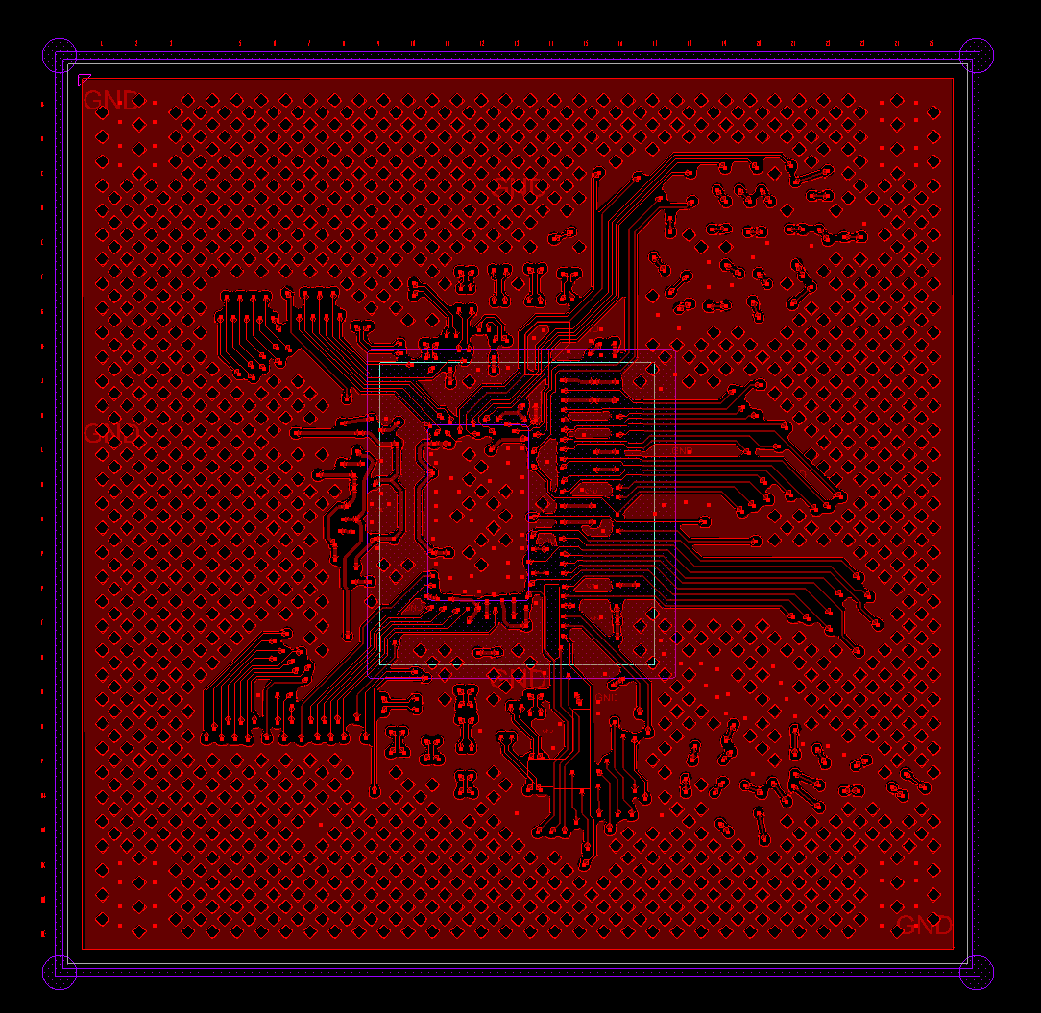

Slide 42
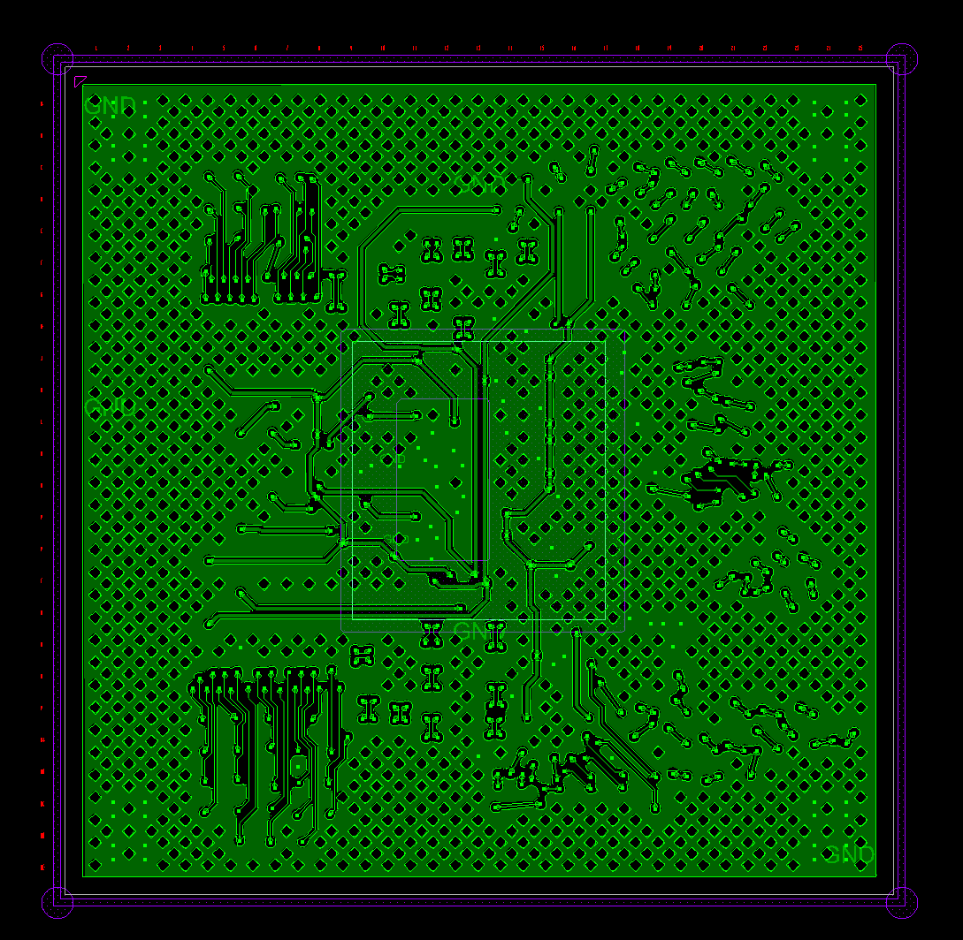

Slide 43
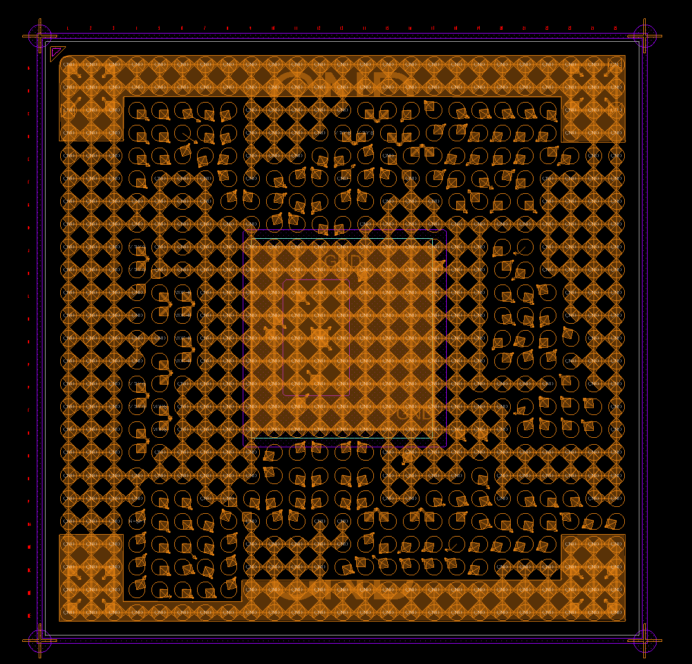

Slide 44
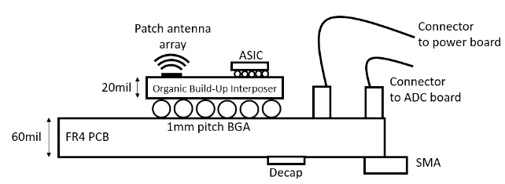
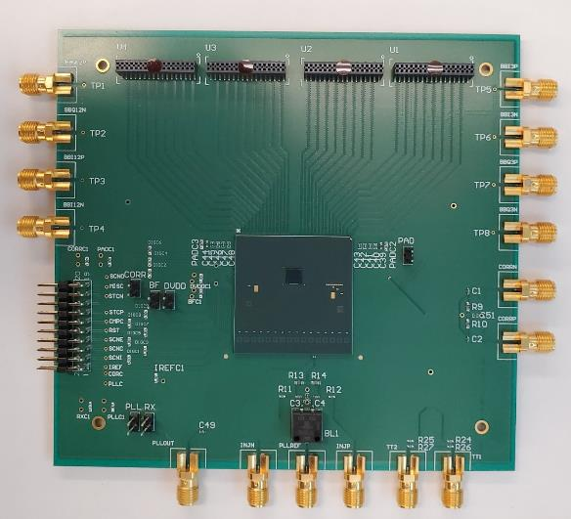
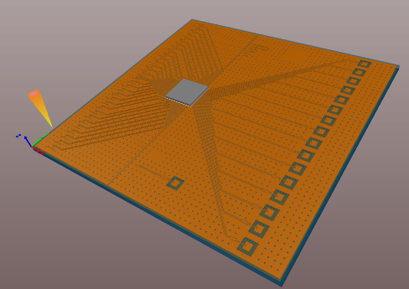
Here’s an example of a recent BWRC project: the Hydra Head IC (16 75GHz receivers). After the die came back from the foundry with its bumps, an interposer was designed for the Kyocera interposer specs. Then the design was sent off to Kyocera for ~2-3 months fabrication time. When it came back, the interposer and die were sent to Quik Pak. Quik Pak did the attachment of the die onto the interposer (the interposer contains the 16 antennas on the top side and has balls on the bottom side. A board was designed and sent to Sierra for fabrication. Finally, the board was assembled (interposer plus SMAs and connectors by Digicom).

Slide 45
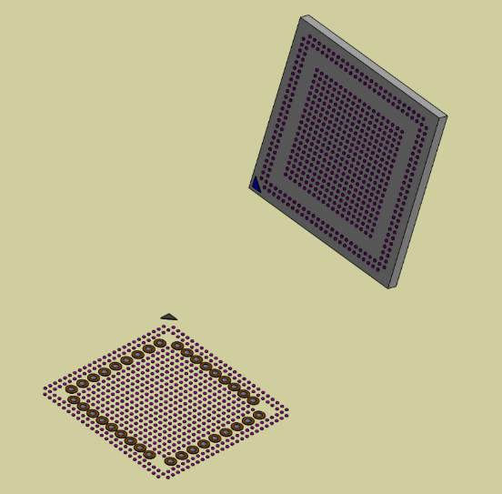
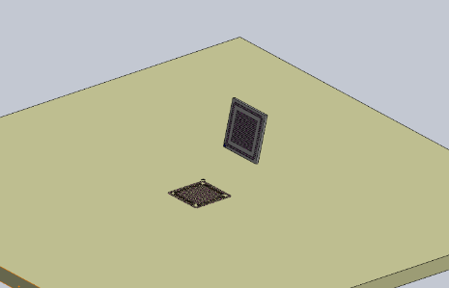
To clarify some more lingo, let’s talk about bumps on a die and pads on a footprint. This is a SolidWorks model intended to explicitly show that the bumps on your die need to be designed in such a way that when the die attach house attaches your die (whether to an interposer or directly to a conventional printed circuit board) you better have an orientation mark … or at least some asymmetry in your bump pattern … such that your die won’t possibly be able to be attached in the wrong orientation to the footprint. This die has a corner mark, as does the footprint.
Die bumps
Footprint pads
Vias in the board layout to escape some of the pads

Slide 46
I use the phrase “die-on-board” to refer to flip-chip attachment of a die directly onto a printed circuit board (as opposed to an interposer). The Eagle project is one example of a die-on-board project.
A27
A2
B28
B1
Photo of the bump side of the Eagle1 die. There’s no actual A1 bump, but the A2-B1 corner (at upper right in this photo) is marked on the board’s footprint (see next slide). Note, that this bump pattern is not rotationally symmetric, so it wasn’t possible to fit on the footprint incorrectly.

Slide 47
This is the Eagle1_daughter_revX2 board:
Corner mark

Slide 48
Close-up of the bottom right corner of the U5 footprint on Eagle1_daughter_revX2:
The blind vias within the footprint (from Layer 1 to Layer 2) are filled, capped-and-plated and then covered with soldermask.
The as-drawn metal for each bump’s pad was 72um and the as-drawn soldermask opening was 1:1 at 72um. The nominal bump diameter was 83um.
The bump pitch was 170um.
The metal plating is ENEPIG.

Slide 49
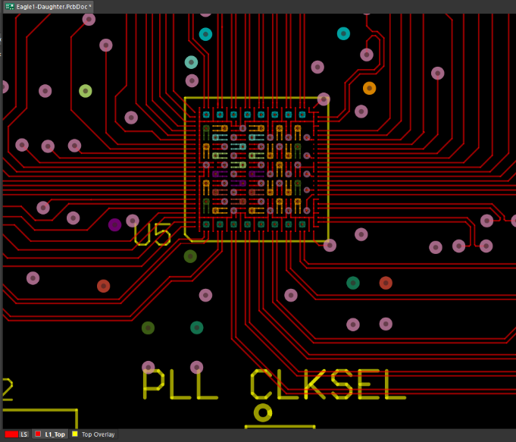
This is the Altium board layout. Eagle’s 692 bumps were designed such that signals only come out at the periphery. Interior bumps are grouped into same-net clusters. This enabled a printed circuit board process to have enough room to put a via between a 2x2 quartet of same-net pads. That, plus some top-layer traces to connect a few nearby same-net pads, allowed for escaping all interior bumps to internal power and ground layers. Still, the vias had to be drilled with the smallest possible drill bit (6 mil diameter). This was a 16-layer board, 62 mils thick (as thick as can be if you want to drill 6 mil holes, because a mechanical drill bit can only drill a 10:1 aspect ratio).
A2-B1 corner

Slide 50
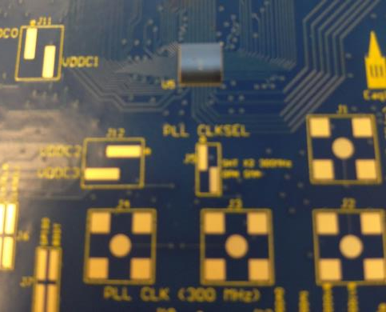
Here is a photo after die-attach (done by Jabil). Backside components had previously been assembled by Digicom (i.e. backside components were sent through Digicom’s solder reflow ovens). After this die-attach step, frontside components were then assembled by Digicom with hand soldering (the boards did not go through Digicom’s oven a second time). The board was specifically designed with no small parts on the top side … only connectors which have to be hand-soldered anyway.
Eagle1 die-on-board

Slide 51
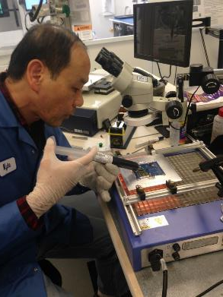
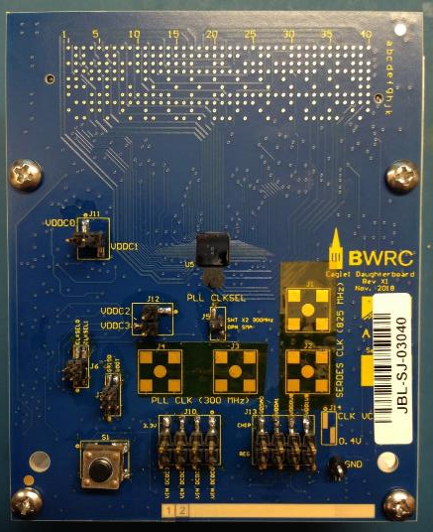
After the die attach step, underfill was injected under the die and then cured. Then frontside components were hand-soldered on:

Slide 52
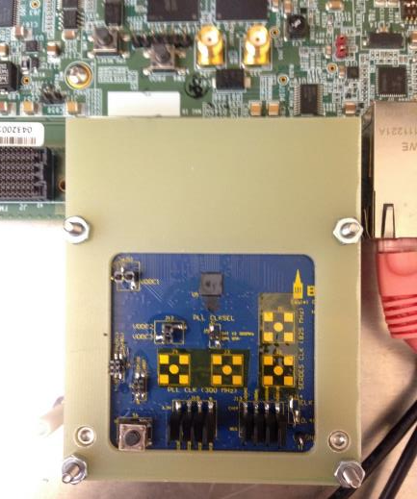
Jabil had warned us that previous customers trying to do similar die-attach processes had seen their dies pop off if their boards had bottom side FMC connectors. The Eagle1 board did have an underside FMC connector, so Jabil recommended that the board be 98 mils thick in order to prevent bending forces during insertion from damaging the die attach. Since the 6 mil drill constrained the thickness to be no larger than 62 mils, we designed the Eagle1 board such that a stiffener could be attached to the board and then removed (for testing access) after plugging into the FPGA:
Stiffener

Slide 53
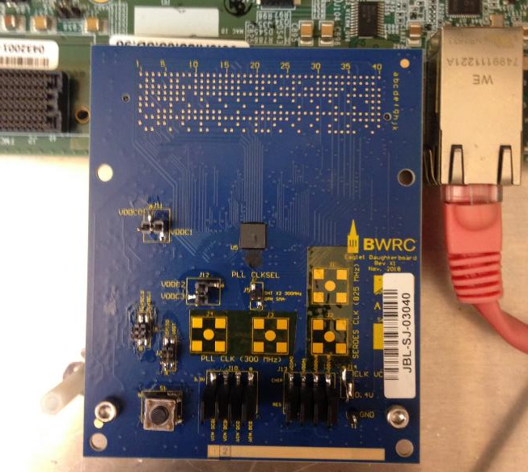
The stiffener was designed to be removable while still enabling the board to remain screwed into standoffs on the test plate:
That is, to make this die-on-board, no package, project work … the die and the board had to be specifically designed to take all these constraints into account. Since a board cannot be fabricated to the tight tolerances achievable with a Keyocera interposer process, the entire board fabrication and assembly process had to be designed together.

